Slide 1
Coptic Lesson 21 Suffix Pronouns

Slide 2
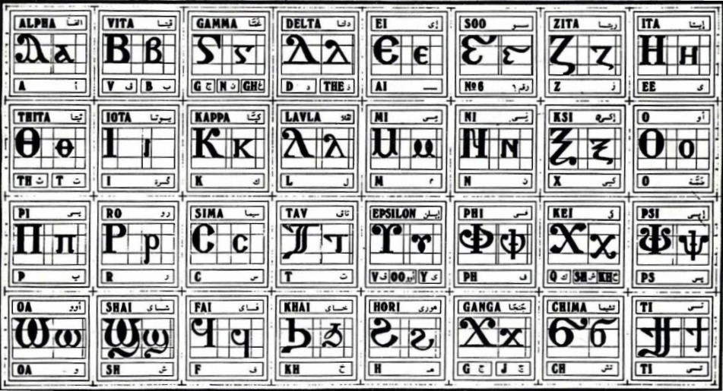
Coptic Alphabets

Slide 3
Review Questions
Coptic
Name
English
Pen¡
pen[oic
Our Lord
==p=n=a
`pneuma
Spirit
=c=w=r
cwtyr
Savior
=n=;
tebi-'it
59
=o=z
`sbe-sasf
77
P=,=c
Pi`,rictoc
The Christ
=o=b
`sbe-`cnau
72

Slide 4
Rule for the Theeta :
th
(Otherwise)
: ; =
t
(after t> s> c)
Examples:
`c;oi (smell)
;wm (lock)
`;myi (righteous)
`s;eh (hot)
;ai (this)
`s;orter (disturbed)

Slide 5
Vocabulary List
`e
to, for, toward
nem
and, with
menre
to love
se
to go
`nta-
belong to
of
`nte
`hna//
to will, to desire

Slide 6
Beginner Vocabulary Review
romi kahi `Vnou] `alou ioh
ry con syri iwt bal
yi ran ro ouro nyb
`chimi vorsi seri ourw ri
cwni ajp ve sau soury
mau ]`alou jij `;nyb hiomi
nicwni nirwmi niran nimau ni`alou
jom niourw nibal nisau ninyb
niseri totc io] ourwou vyou`i

Slide 7
Suffix Pronouns
- i > -t
- k
- e
- f
- c
- n
- ten
- ou
me
you (masculine)
you (feminine)
him
her
us
you (plural)
them

Slide 8
Exercise (Part 1)
Add Suffix Pronouns to the following:
`ero//
to, for
nema//
with
nahra//
before
`nta//
belong to
sena//
to go to
tyr//
all of
ebolhitot//
by, through
qarw//
in front of, beneath

Slide 9
Exercise (Part 2)
From the Liturgy:
]sep`hmot `ntotk
I thank You
`ntefsenhyt qaron
He may have compassion on us
`alitou `ebolharon
Take them away from us
Ariten `nem`psa `njoc
Make us worthy to pray (say) it
Sa `eneh `nte ni`eneh tyrou `amyn
Unto the age of all ages, amen
Swpi neman `amyn
Be with us, amen
Pi`hmot gar nemwten
Grace be with you
Afwopten `erof
Accepted us to Him

Slide 10
Announcement
All slides are available at http://www.ekladious.com/coptic.html

Slide 11

Oujai qen `P[oic

